Slide 1


Laptop Price Analysis
Sudip Dey

Slide 2

Project Overview
Dataset is available in the given link: https://drive.google.com/file/d/1sU3TLwZA306lXScMvY_qgZs7-BvffSEw/view?usp=drive_link

Slide 3
About Dataset
The dataset contains 1,275 entries and 23 columns related to laptop specifications, including details about:
General Information: Company, Product, Type (e.g., Notebook, Ultrabook).
Specifications: Screen size (Inches), RAM, Operating System, Weight, and Price.
Display Features: Screen resolution (Width and Height), Touchscreen, IPS panel, Retina Display.
Processor Information: CPU company, frequency, model.
Storage: Primary and secondary storage capacity, and storage type (SSD, HDD).
Graphics: GPU company and model.

Slide 4
Project Goal
Let's analyze some key insights from this data, focusing on:
Price Distribution and Factors Influencing Price: We’ll examine how attributes like company, RAM, CPU, and storage type affect the price.
Storage and Display Features: We’ll analyze storage and display preferences across different laptop types.
Performance Characteristics: Exploring CPU frequency and RAM across different brands and types to see how they impact laptop performance characteristics.

Slide 5
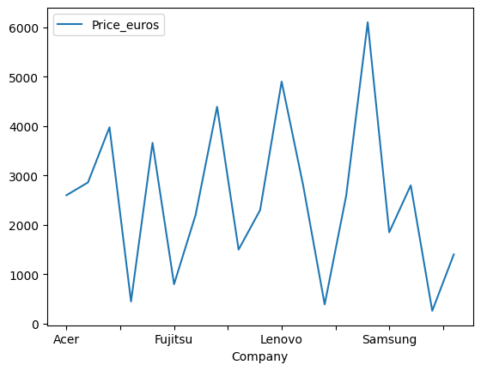
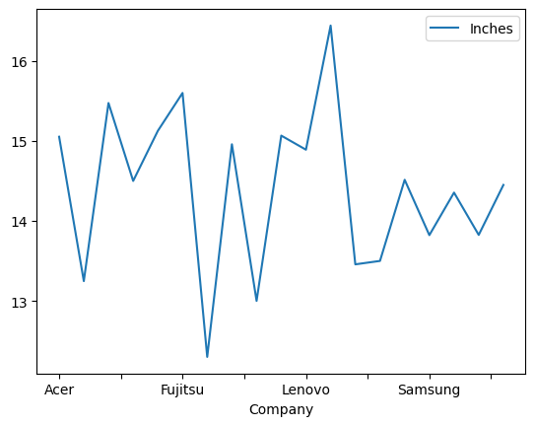
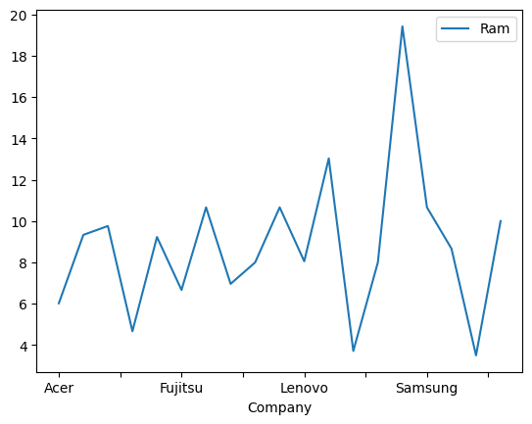
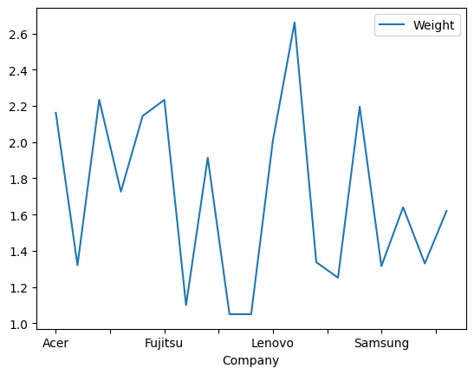
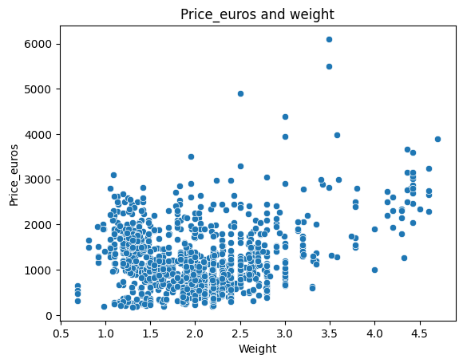
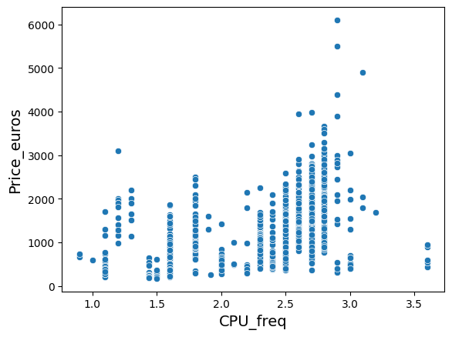
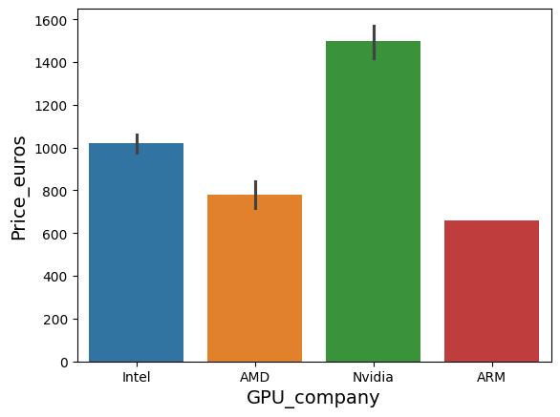
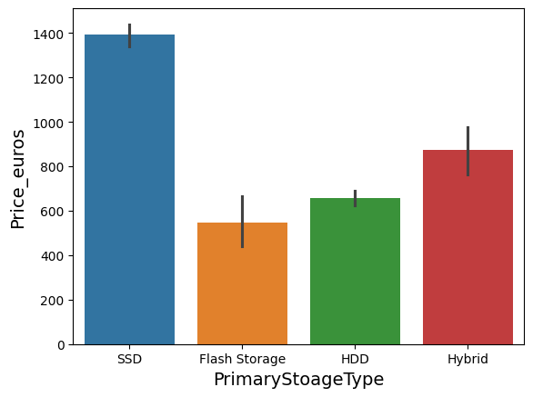
Analyses

Slide 6
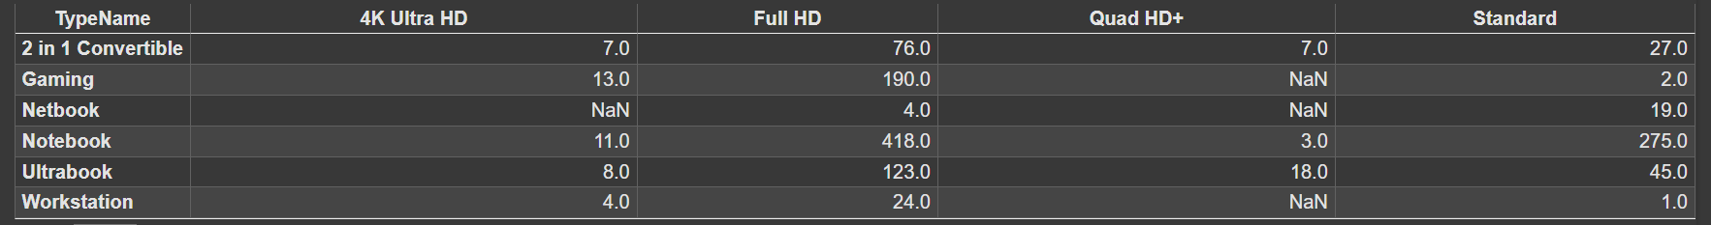
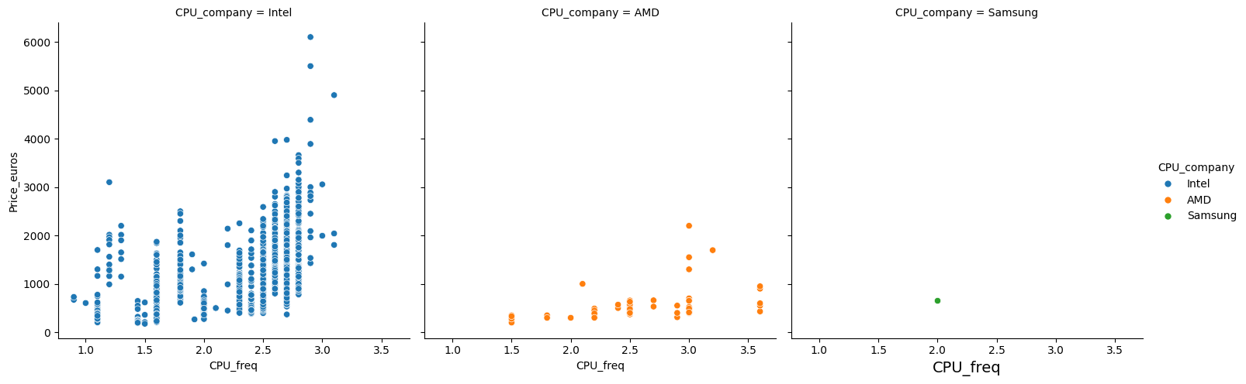
Analyses

Slide 7
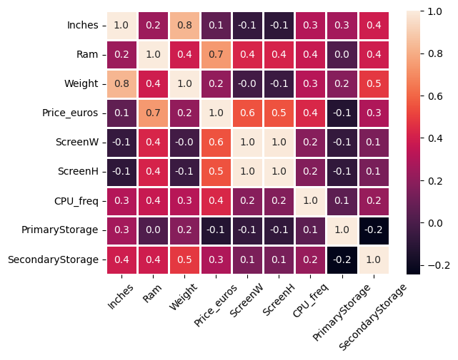
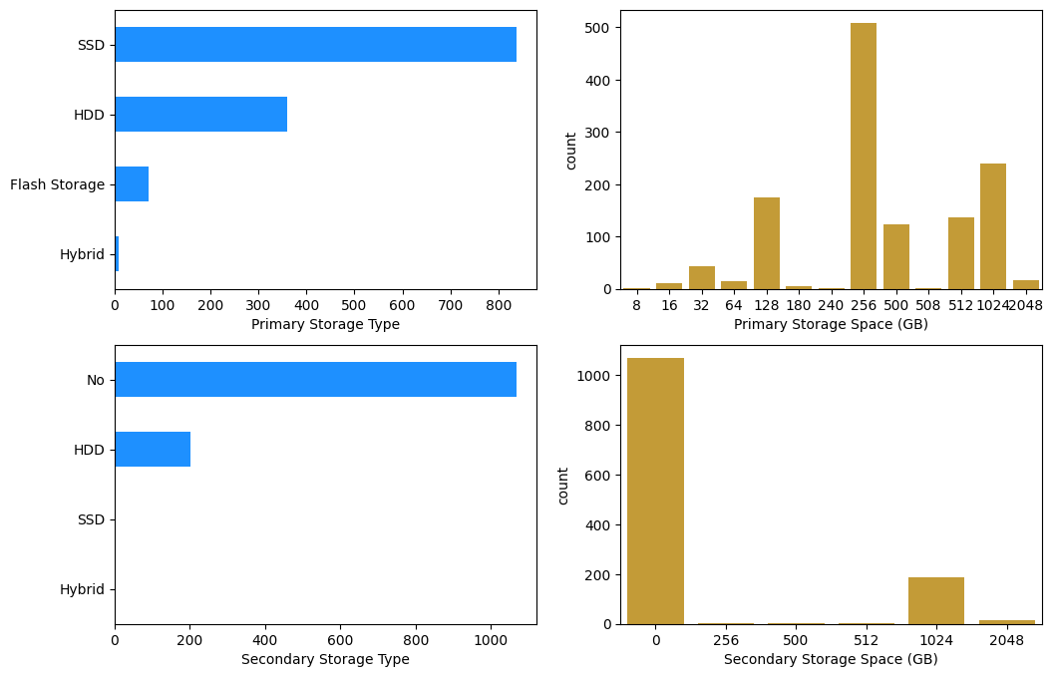
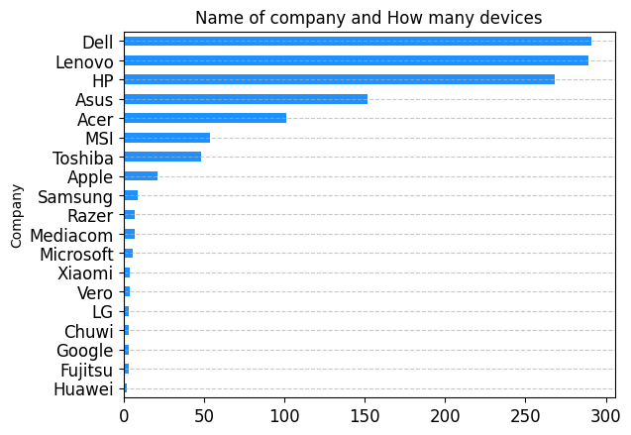
Analyses

Slide 8
Conclusion and Insights
Price Distribution:
The price distribution is positively skewed, with most laptops priced under €1500. A few high-end laptops reach significantly higher prices, likely driven by premium features or brand value.
Price by Company:
Apple laptops are priced noticeably higher on average, followed by Razer and Microsoft, suggesting these brands focus on premium models.
Companies like HP, Acer, and Dell have a wider range of prices, offering models across different price segments, while brands such as MSI and Alienware seem more concentrated around higher price points, likely targeting gaming or performance-focused customers.
Price vs. RAM:
As expected, laptops with higher RAM generally command higher prices. Models with 16GB and 32GB RAM show a substantial increase in price, reflecting their target audience's demand for performance.

Slide 9
Conclusion and Insights
Price vs. Storage Type:
Laptops with SSD storage are generally more expensive than those with HDDs, likely due to the performance and efficiency benefits associated with SSDs. Flash storage, typically found in ultrabooks, also tends to be higher priced, aligning with their slim, high-performance build.
Price vs. CPU Frequency by CPU Company:
Laptops with higher CPU frequencies often come at a higher price. Intel-based laptops dominate the market, while AMD models appear in both high and mid-frequency ranges, generally showing competitive pricing.
Google Colab( Laptop price analysis ): https://colab.research.google.com/drive/1g74f3AgnrIzWcydMydLlWNZ8pxWA-TPu?usp=sharing

Slide 10
Thank you.

